Slide 1
Building Better Participation Infrastructure
Matt Leighninger mattleighninger@earthlink.net
&
Tina Nabatchi tnabatch@syr.edu

Slide 2
The book and a number of free resources (slide decks, skills module, readings) are available under the “Downloads” heading at:
http://bit.ly/PP21CDresources
The skills module can be downloaded directly at:
http://bit.ly/PPskills
Save 30%!
Use Promo Code:
WLY14 during check out at www.wiley.com

Slide 3
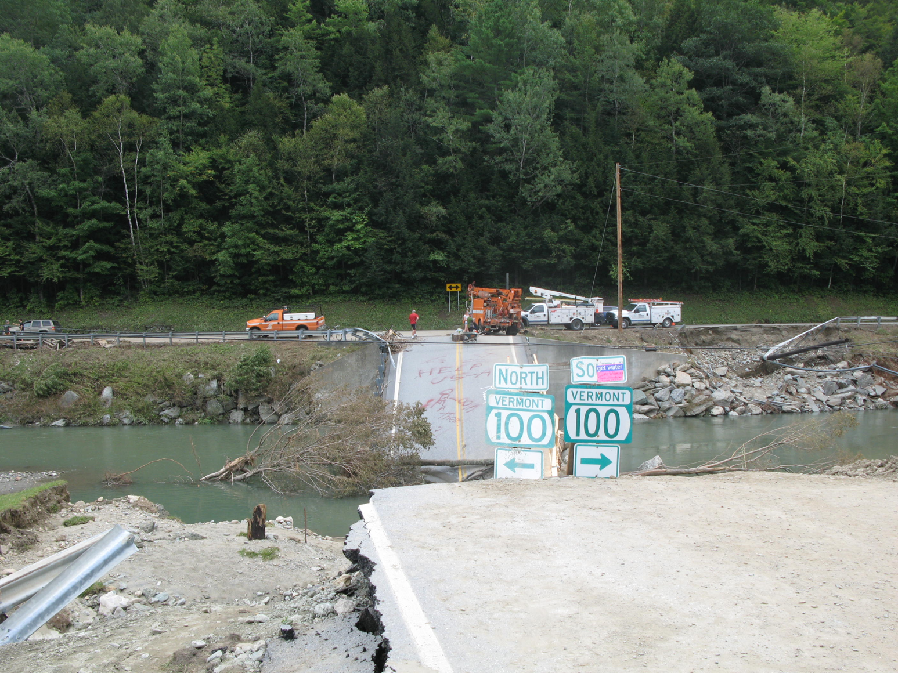
Public participation could help us address many public problems
BUT
Our participation infrastructure is outdated, weak, and inefficient.
It is not up to the task.

Slide 4
Participation Infrastructure
The laws, processes, institutions, and associations that support regular opportunities, activities, and arenas that allow people to connect with each other, solve problems, make decisions, and be part of a community.
Notes:
Facets of our participation infrastructure
Legal
Governmental
Civic
Electoral
Educational
Our current participation infrastructure occupies a great deal of time, money, and political capital, BUT it is inefficient, ineffective, and outdated.
It does not support “good” participation, does not meet the needs of citizens or officials, and does not reflect the way people live today.

Slide 5
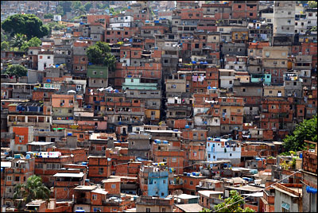
Why do we need a better participation infrastructure?
Long term impacts of sustained participation:
Lower corruption
Lower inequality
Better public health outcomes
More economic growth
More community connectedness
Higher trust in government
Higher tax compliance
Higher completion rates for government projects
Officials more likely to be reelected

Slide 6
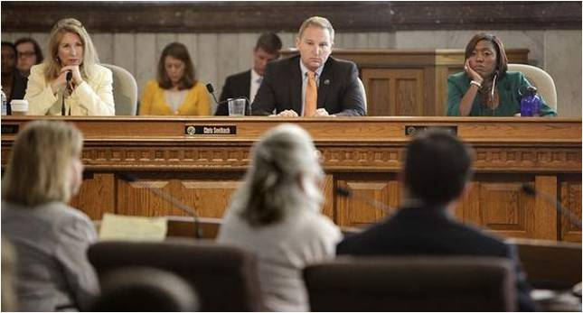
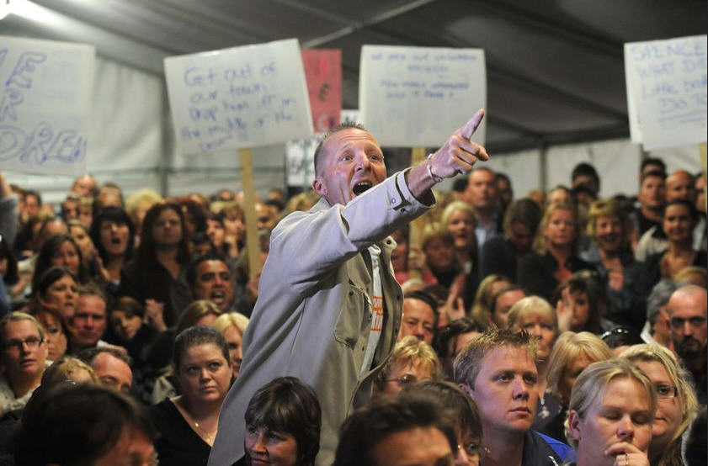
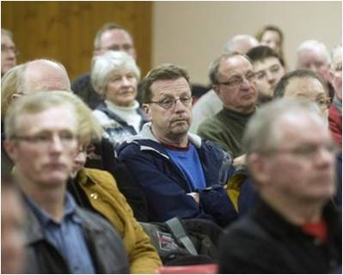
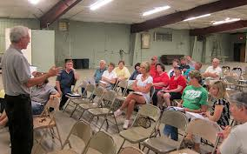
Three Minutes at the Microphone

Slide 7
Three Minutes at the Microphone
The default structure for participation reinforces the status quo:
Agenda is pre-set by officials
NO discussion outside the agenda
Oriented to getting comments in the record
Easy to disrupt
The physical layout reinforces power and other disparities

Slide 8
How can we improve our public participation infrastructure?
Give Good Process! Treat citizens like adults.
Understand Thick and Thin Participation (and how to combine them).
Empower and activate Participation Leaders and Networks
Assemble the Building Blocks of Participation
Provide Systemic Supports

Slide 9
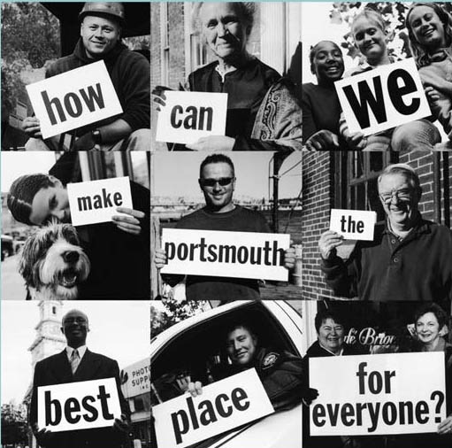
Give Good Process!
Treat citizens like adults. Give them respect, recognition, and responsibility
Information and choices
A chance to tell their stories
A sense of political legitimacy
Opportunities to take action
Participation experiences that are enjoyable, easy, and convenient
Notes:
Do you agree with the claims about what makes for “good” participation? Why or why not?
Discuss the characteristics of an adult-adult relationship. Do you believe it is important to incorporate these characteristics into public participation? Why or why not?
What would you do to integrate these characteristics into public participation?

Slide 10
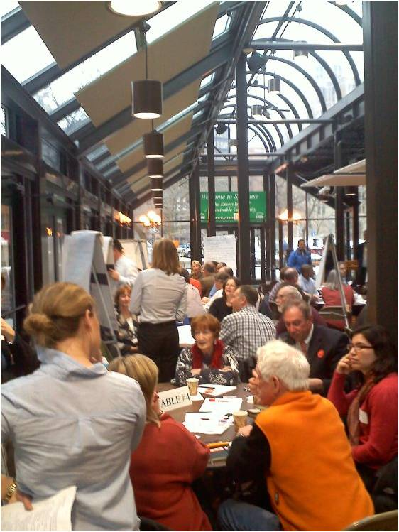
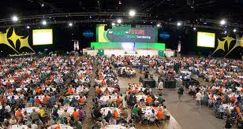
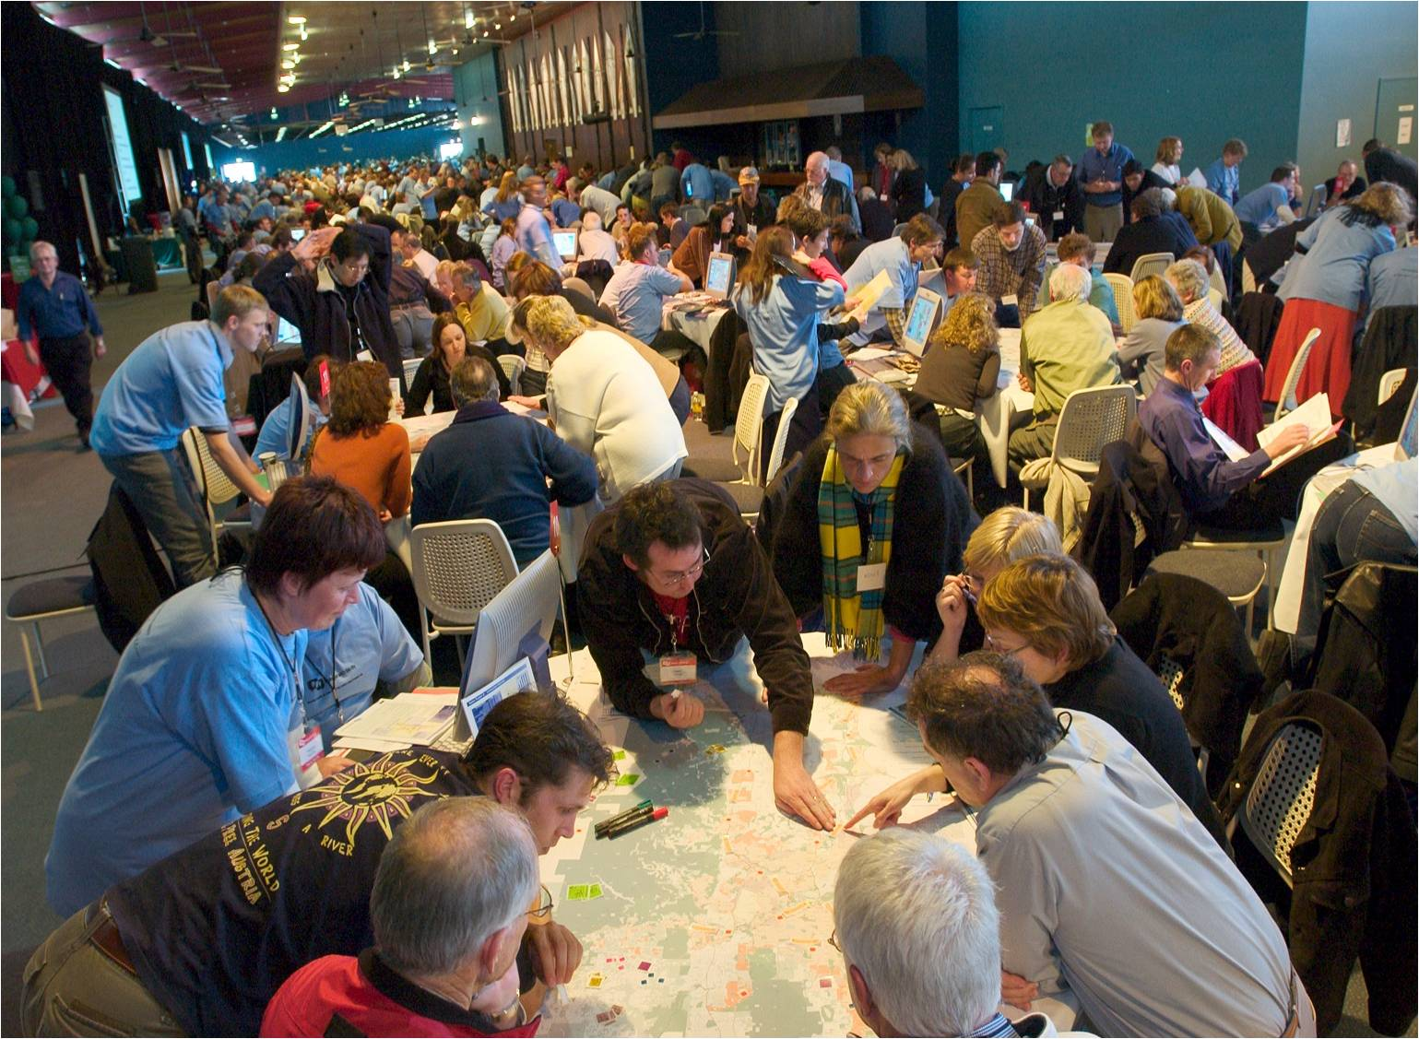
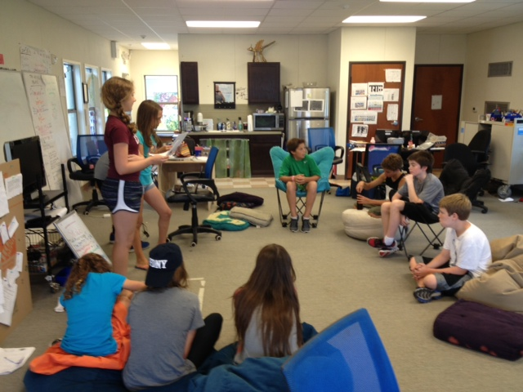
Thick Participation

Slide 11
Thick Participation
Thick participation empowers groups and can lead to more effective problem solving.
Proactive, network-based recruitment to attract a diverse, critical mass
Small-group discussion with impartial facilitators
Information sharing and issue framing to give views and options
Decision making and/or action planning

Slide 12
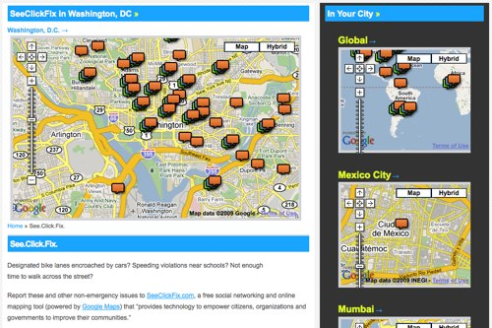
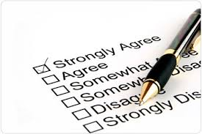
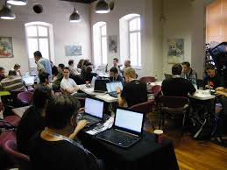
Thin Participation

Slide 13
Thin Participation
Thin participation empowers individuals and can inform effective problem solving. Many new thin opportunities allow us to:
Affiliate with a cause
Rank ideas
Donate money/crowdfund
Play serious games
Provide discrete data on public services/problems

Slide 14
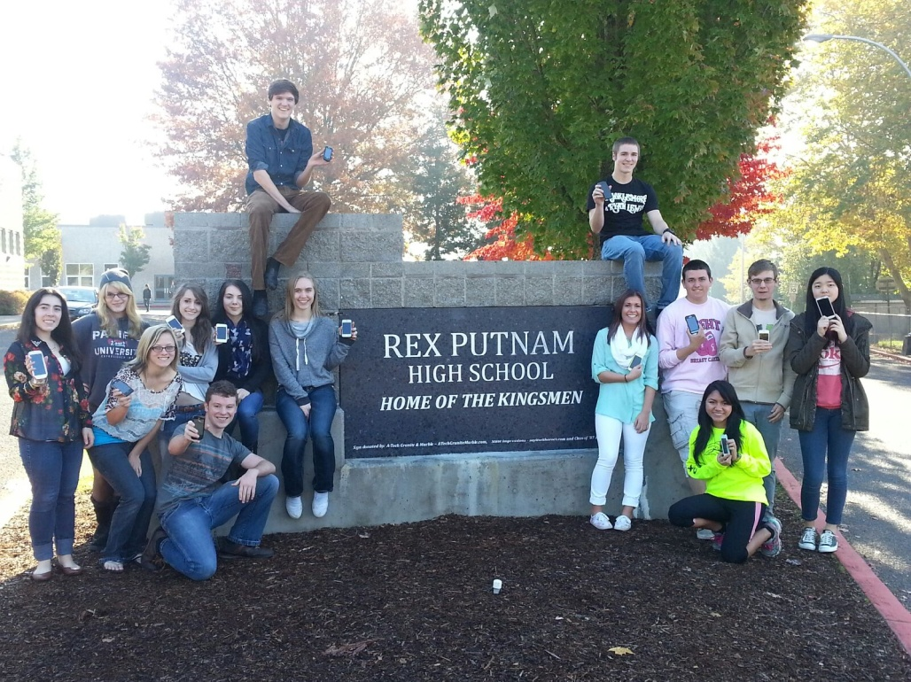
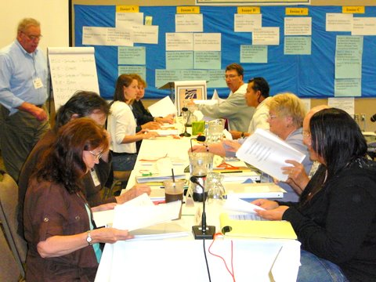
Combining Thick & Thin Participation
Sustaining community connections
“Text Talk Act”
National Dialogue on Mental Health
“Citizen’s Initiative Review”
Oregon

Slide 15
Empower & Activate Participation Leaders and Networks
Leaders
Elected Officials
Public Servants
Civic Leaders
Participation Professionals
Networks
Schools, colleges, universities
Businesses
Nonprofits and foundations
Community and youth groups
Social service agencies
Unions
Media
Homeowner / neighborhood associations

Slide 16
Assemble Participation Building Blocks
Disseminating Information
Gathering Input and Data
Enabling Small-Scale Decision Making
Enabling Large-Scale Decision Making
Discussing and Connecting
Encouraging Public Work

Slide 17
Building Blocks for Participation
Traditional Media
Social Media
Websites
Texting Systems
Dashboards and Apps
Serious Games
Robo Calls
Town Halls & Tele-Town Halls
Interactive Community Maps
Disseminating Information
This is the most basic building block.
Technology has made it easier than ever.
Notes:
How does technology encourage participation in education? What are the advantages and disadvantages of integrating technology such as social media or online dashboards in education?

Slide 18
Building Blocks for Participation
Surveys, Polls, Interviews, Focus Groups
Crowdsourcing, Competitions
Apps for Identifying Problems
E-Petitions
Wikis
Impact Assessments and Rating Systems
Geo-Technologies
Face-to-Face Exercises
Gathering Input and Data
Citizens can also provide information.
Consider: is there a “civic upsell” from one opportunity to the next?

Slide 19
Building Blocks for Participation
Wired, Welcoming Physical Spaces
Online Forums and Networks
Fairs, Festivals, Celebrations, other Social Events
Text-Enabled Small Group Dialogue
Face-to-Face Deliberative Events
Discussing and Connecting
The social aspects of participation are critical for building relationships.
Relationships are key to a sustainable infrastructure.
Notes:
What are the benefits and drawbacks of using school facilities for public participation? Do the schools in your community have a place-making function? If so, how? If not, why?

Slide 20
Building Blocks for Participation
Citizens want to make day-to-day decisions, and need thin and thick opportunities.
Enabling Small-Scale Decision Making
(individuals, families, groups, neighborhoods)
Participatory Public Meetings
Meetings and Interactions with Professionals (e.g., school officials, healthcare providers)
Online Tools and Technologies
Fairs and Social Events
Neighborhood Associations and Councils, HOAs
Walkshops, Tactical Urbanism

Slide 21
Building Blocks for Participation
Citizens want to influence policy decisions.
This requires building participation into the regular functioning of government.
Enabling Large-Scale Decision Making
(communities, cities, regions, state & federal government)
Deliberative Events
Participatory Budgeting
Participatory Meetings of “Official” Decision Making Bodies
Advisory Boards and Councils
Community Coalitions
Policy Conferences
Ballot Initiatives and Referenda

Slide 22
Building Blocks for Participation
A strong participation infrastructure will encourage citizens to expend time, energy, and sweat equity.
Encouraging Public Work
Volunteer Coordination and Mini-Grant Programs
Apps and Platforms for Teams and Tasks
Collaborative approaches to maintaining public resources
Service opportunities connected to problem-solving
Notes:
What does the term “public work” mean?

Slide 23
Provide Systemic Supports
Incentives for participation leaders
Training and skill development
Financial and other resources
Policies and procedures
Evaluation measures and benchmarks
Notes:
Explain the three elements of building a stronger participation infrastructure. Do you think the authors missed any critical elements?
What do democracy and participation mean to you? If you are not from the United States, how does the experience of participation in your country compare to the American experience?

Slide 24
Connecting the Building Blocks for Participation
Some “universal pieces” that can support and connect participation infrastructures:
Hyperlocal and Local Online Networks
Buildings that are Physical Hubs for Participation
Youth Councils
Participation Commissions (or Advisory Boards)
Can advise on the design, implementation, and evaluation of specific participation tactics
Can focus on building and embedding a sustainable participation infrastructure
Notes:
Develop a plan for creating a participation commission in your community or for an issue. Where would it be housed? Who would be on it? What would be its responsibilities?

Slide 25
Systemic Supports for Participation
Three additional supports that can buttress participation by helping people develop their skills
Local Participation Ordinances
Most laws governing participation are at least 30 years old
Working Group on Legal Frameworks for Participation has created new tools and a model local ordinance
Citizen’s Academies and Participation Training Programs
Can be used to inform citizens about the importance of participation, issues for participation, and skills for practice
Online Participation Dashboards
Can be used to track data on turnout, demographics, and participation satisfaction and measure overall quality of efforts
Notes:
Do you believe it is important to develop a local participation ordinance? Why or why not?
Does your community have a citizens’ academy or other training programs? If so, what is the current curriculum for that program? Does it include participation? How might participation be incorporated into that program?

Slide 26
Envisioning Stronger Participation Infrastructure
Make participation a cross-sector priority
Use plainer, more compelling language
Encourage progressive and conservative visions
Use visual aids, like charts and maps
Encourage artistic expressions of democracy
Notes:
The authors assert that the language of participation is not clear or compelling, and that it fails to capture both progressive and conservative visions. Do you agree with these claims? Why or why not? What are your suggestions for talking about participation in a way that is exciting and understandable to people, regardless of their political views?
How would you go about mapping the participation activities taking place in your community? What information, opportunities, and other ideas are available? Where are there gaps?
Channel your inner creative genius and develop an artistic expression of a participation infrastructure. Why did you make the choices you made?
Some have suggested using analogies to explain the idea of a participation infrastructure, for example, likening it to a human body or to physical architecture. What analogy or analogies would you use to explain participation infrastructure?

Slide 27
The book and a number of free resources (slide decks, skills module, readings) are available under the “Downloads” heading at:
http://bit.ly/PP21CDresources
The skills module can be downloaded directly at:
http://bit.ly/PPskills
Save 30%!
Use Promo Code:
WLY14 during check out at www.wiley.com

